Slide 1
Career Center Overview Dunlap Success Center
Notes:
Recommended CareerSpots videos for this workshop:
Why Visit the FSU Career Center: https://www.youtube.com/watch?v=s1v8gsbVmHI
Use Your Career Center: http://www.careerspots.com/newplayer/default.aspx?key=-4FXWjbYVKQTOhe55MHi3Q2&
Career Center Benefits: http://www.careerspots.com/newplayer/default.aspx?key=lEyILhMNL0QAA0Oj48txnA2&

Slide 2
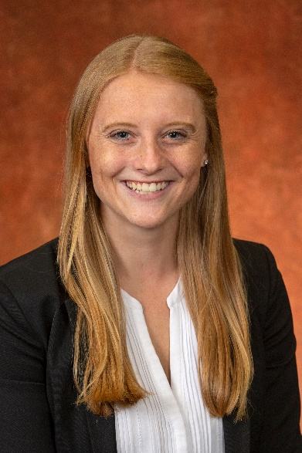
Meet your Graduate Career Liaison
Megan Crowe
Graduate Career Liaison
m.crowe@fsu.edu
850-644-8139
Virtual Appointments
Tuesday-Wednesday-Thursday
1:00pm – 4:45pm

Slide 3
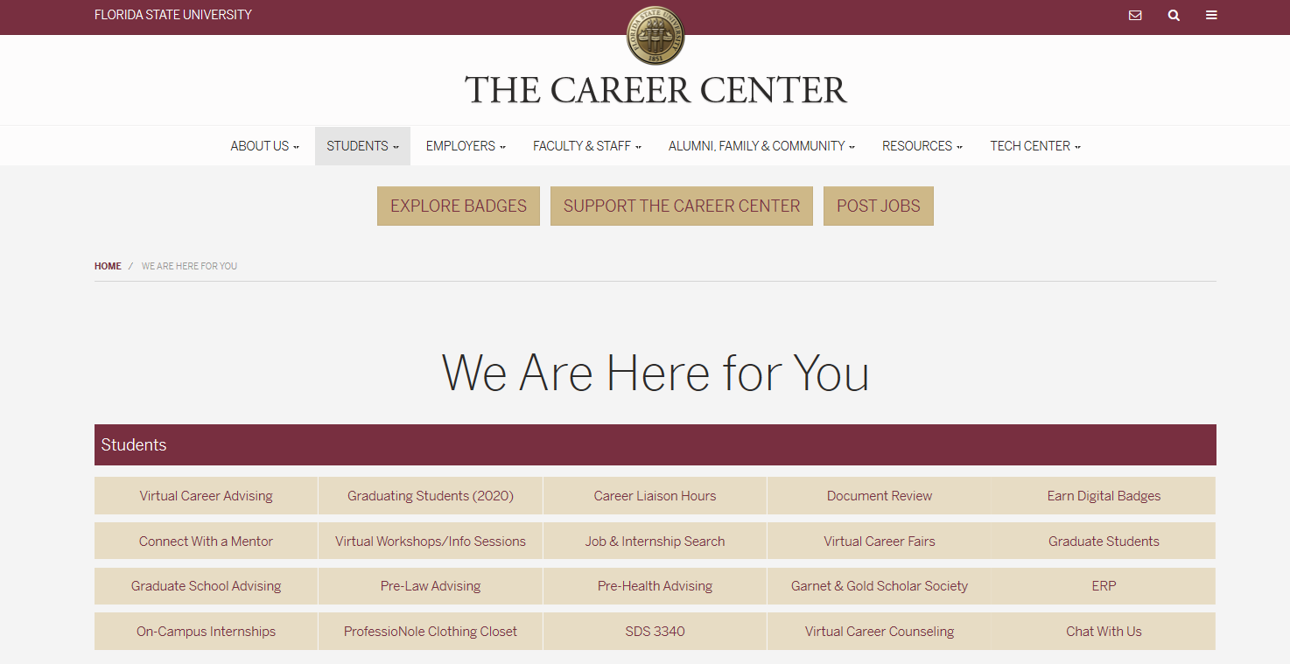
Virtual Career Center
career.fsu.edu/info

Slide 4
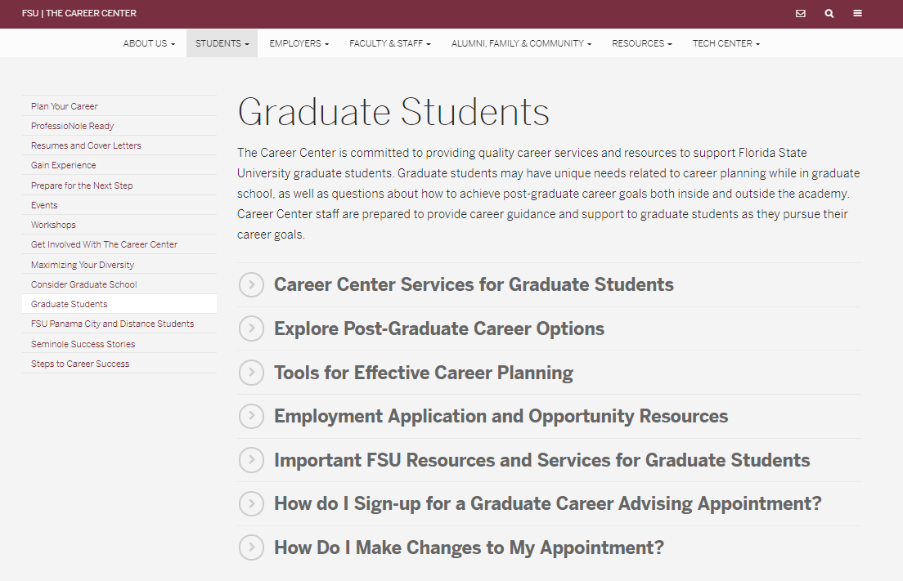
Explore Your Options
For more information: career.fsu.edu (Students tab)
Notes:
The Career Center is here to support your needs as graduate students:
Introduce topics of advising covered by liaisons and Career Advisors
Link to Graduate Student webpage on our website
Provide an overview of the GPNR Program for grad students

Slide 5
Prepare for your Job Search
Get started today:
Have your Résumé/CV reviewed each semester
Create a portfolio to hold artifacts of your work, badges and certifications
Use LinkedIn Learning and Digital Badges to expand your skill sets
Complete a Mock Interview/ Big Interview to enhance your interviewing skills
Need ideas for how to prepare? Meet with your Career Liaisons today!
Notes:
Life as a graduate student can get busy. Do not wait until you are about to graduate to begin preparing for your job search. Get started today:
You do not need to have all of the steps figured out, meet with your liaisons to discuss your path and steps to help you reach your career goals.

Slide 6
Connect with a Mentor
Conveniently search for short or long term- mentorship using ProfessioNole Mentors:
As a graduate student you can also serve as a mentor to undergraduates. Create both of your profiles today!
Filter for the topics and traits you care about
Match with the mentors of your choice
Learn from subject matter experts

Slide 7
Launch your Job Search
Attend Virtual Career Fairs
20+ Career Fairs offered per year
Seminole Futures All Majors Career Fair
Government and Social Services Career Fair
Education & Library Career Fair
Graduate & Professional School Fair
Law School and Graduate School Fair
Academic and Industry Job Databases Available
For more information: career.fsu.edu (Events)

Slide 8
Meet your Graduate Career Liaison
Megan Crowe
Graduate Career Liaison
m.crowe@fsu.edu
850-644-8139
Virtual Appointments
Tuesday-Wednesday-Thursday
1:00pm – 4:45pm

