Slide 1
Welcome To FSU
Karibuni
स्वागतम्
أهلاً و سهلاً
Bienvenue
Hoşgeldiniz
ᎤᎵᎮᎵᏍᏗ
Bienvenidos
Welkom
Willkommen
Bem-vindos
Velkommen
欢迎光临
Ἀσπάζομαι!
환영합니다
Aloha
歡迎光臨
Isten hozott
Haykuykuy!
ようこそ
أهلاً و سهلاً
Benvenuti
Merħba
स्वागत

Slide 2
The Congress of Graduate Students

Slide 3
1. What is COGS and What does COGS do? 2. How Can you Have Fun and get Involved?

Slide 4
The Official Statement
We are the official representative body of graduate students at Florida State University
Post-Baccalaureate
Special
Master’s
Specialist
Professional
Doctoral

Slide 5
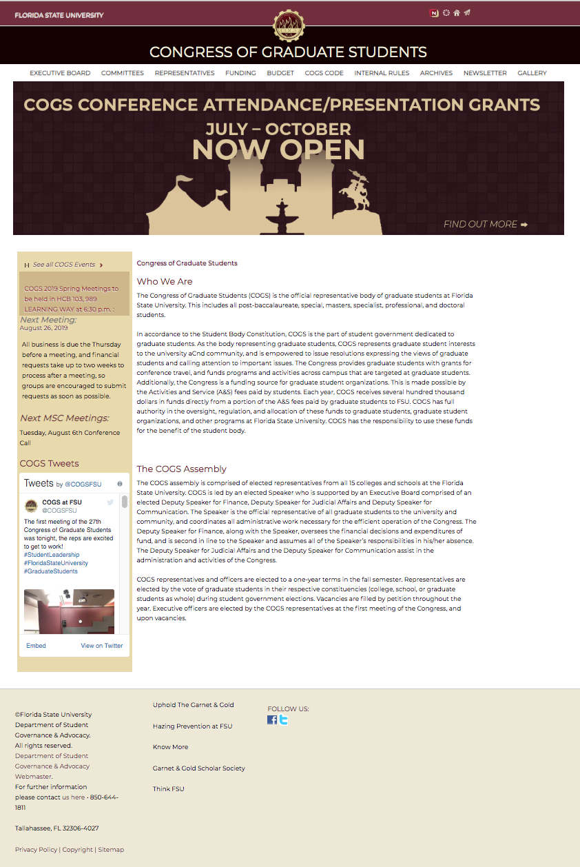
sga.fsu.edu/cogs

Slide 6
Funding
Graduate RSOs
Individual Presentation & Attendance Grants
Law School Council
Medical School Council

Slide 7
Compensation for Travel Up to $500 Total per Fiscal Year
Presentation Grant
Attendance Grant
Up to $200 within Contiguous US
Up to $500 Internationally
including Hawaii and Alaska
Up to $100 anywhere
Notes:
List dollar amounts for grants
Get what is defined as “presentation”

Slide 8
Compensation for Travel Fine Print – What you need
Presentation Grant
Attendance Grant
Proof of conference registration
Acceptance letter or preliminary program
Proof of conference registration
Notes:
List dollar amounts for grants
Get what is defined as “presentation”

Slide 9
Compensation for Travel Fine Print – Three Time Periods
Paperwork Due 15 Days Prior to Travel
1 July – 31 October (Application opens 1 June)
1 November – 28/29 February (Application opens 1 October)
1 March – 30 June (Application opens 1 February)
Notes:
List dollar amounts for grants
Get what is defined as “presentation”

Slide 10
1. What is COGS and What does COGS do? 2. How Can you Have Fun and get Involved?

Slide 11
Become a Representative
Applied Studies
Arts & Sciences
At Large
Business
Communication & Information
Criminology & Criminal Justice
Education
Engineering
Fine Arts
Graduate Student Housing Advocate
Human Sciences
International Student Advocate
Law
LGBTQ+ Student Advocate
Medicine
Minority Student Advocate
Motion Picture Arts
Music
Nursing
Panama City Campus Senator
Social Sciences & Public Policy
Special/Undecided Advocate
Students with Disabilities Advocate
Veterans Advocate
Notes:
Representatives Page on website – Everything without an underline has open/available seats

Slide 12
Getting involved Over 30 seats available
Representatives:
Empower graduate students to build community
Offer opportunities for graduate students to present their research
Advocate for the needs of graduate students in your department

Slide 13
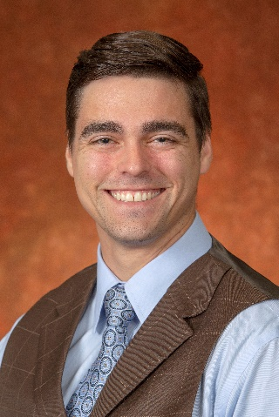
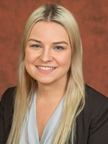
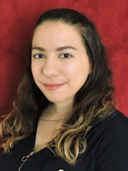
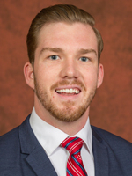
Cogs Leadership Team
Michael J. Morgan, Jr. Speaker
COGSSpeaker@admin.fsu.edu
Caitlyn Blake-Hedges Dep. Speaker, Finance
COGSDepSpeaker@fsu.edu
Tiffani Mendez Dep. Speaker, Comm.
SGA-COGS-Communications@fsu.edu
Blake Mathiese Dep. Speaker, Judicial Affairs
Joining COGS: SGA-COGS-JA@fsu.edu

Slide 14
Follow us on social media
Facebook: FSUCOGS
Twitter: COGSFSU

