Slide 1
Career Center Overview
Notes:
Recommended CareerSpots videos for this workshop:
Why Visit the FSU Career Center: https://www.youtube.com/watch?v=s1v8gsbVmHI
Use Your Career Center: http://www.careerspots.com/newplayer/default.aspx?key=-4FXWjbYVKQTOhe55MHi3Q2&
Career Center Benefits: http://www.careerspots.com/newplayer/default.aspx?key=lEyILhMNL0QAA0Oj48txnA2&

Slide 2
Overview
Presentation Overview
Who to connect with
Where to get started
How we can help

Slide 3
Who to Connect With: As a graduate student know that you are not alone in your career development. The Career Center has dedicated Career Advisors, Liaisons and staff to support you in this process.

Slide 4
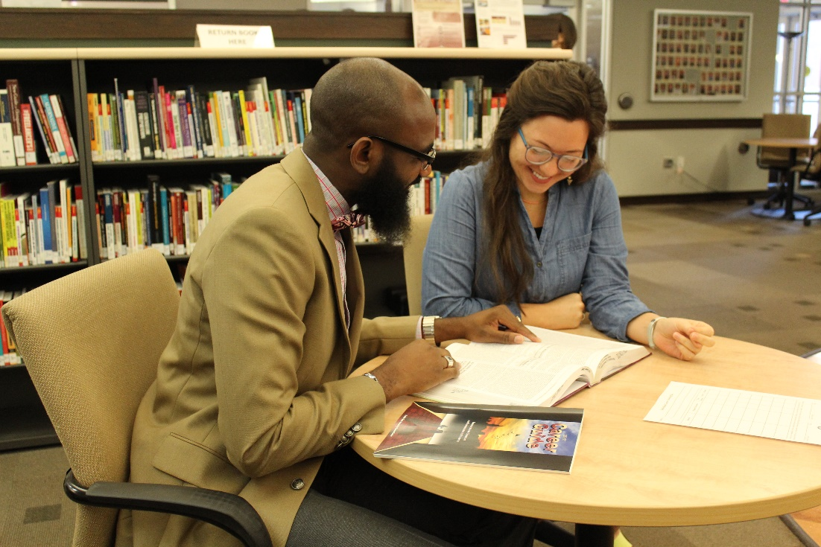
Drop-In Advising Available No appointment needed!
Monday – Friday, 9:00 a.m. – 4:30 p.m.
**Closed Fridays, 1:30 – 2:30 p.m. (Team Meeting)
Meet with a Career Advisor to discuss:
Your application documents (Resume, CV, Cover Letter etc.)
Career Exploration
Attending Career Fairs & Learning to Network
Your LinkedIn Profile
Job Shadowing, Internships, Part-Time Jobs
Launching your Full-time Job Search
Finding a Mentor
And more!

Slide 5
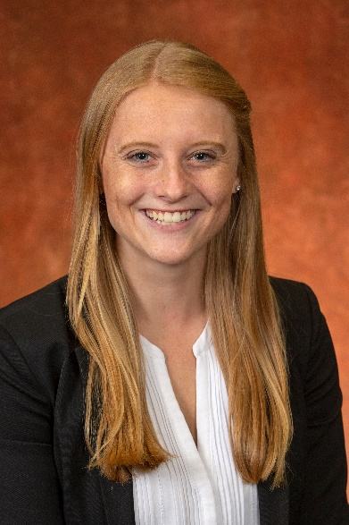
Meet your Graduate Career Liaison
Megan Crowe
Graduate Career Liaison
m.crowe@fsu.edu
Appointments
https://www.career.fsu.edu/nolenetwork
Tuesday-Wednesday-Thursday
1:00pm – 4:45pm
Other days and times available upon request

Slide 6
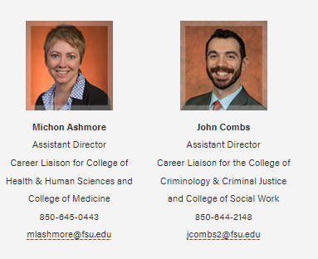
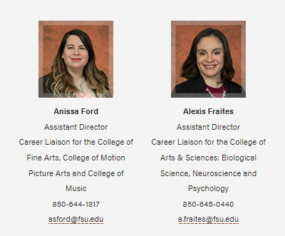
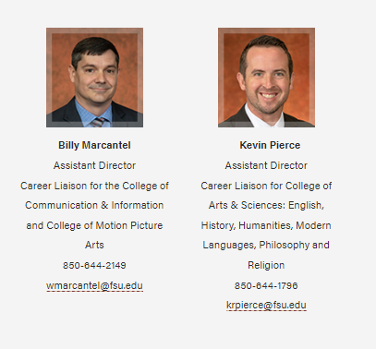
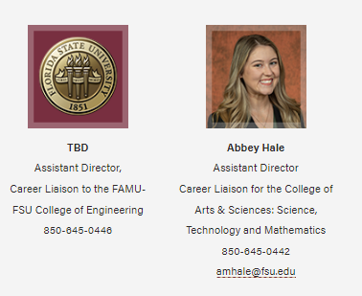
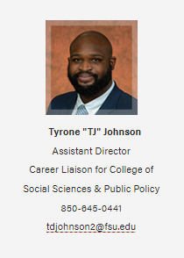
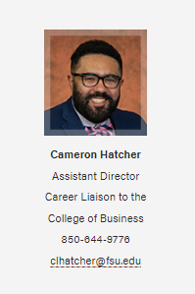
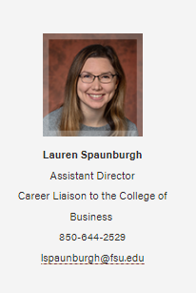
Visit: https://career.fsu.edu/about-us/career-liaisons for the most updated list of liaisons and their drop-in hours
Academic Area Liaisons: As a graduate student you have access to a variety of liaisons to meet your career needs. Consider meeting with your college’s Career Liaison.

Slide 7
Where to Get Started: It can be overwhelming as you acclimate to graduate school. The next few slides will provide you with resources and steps for getting started to help you keep your focus on your career goals.

Slide 8
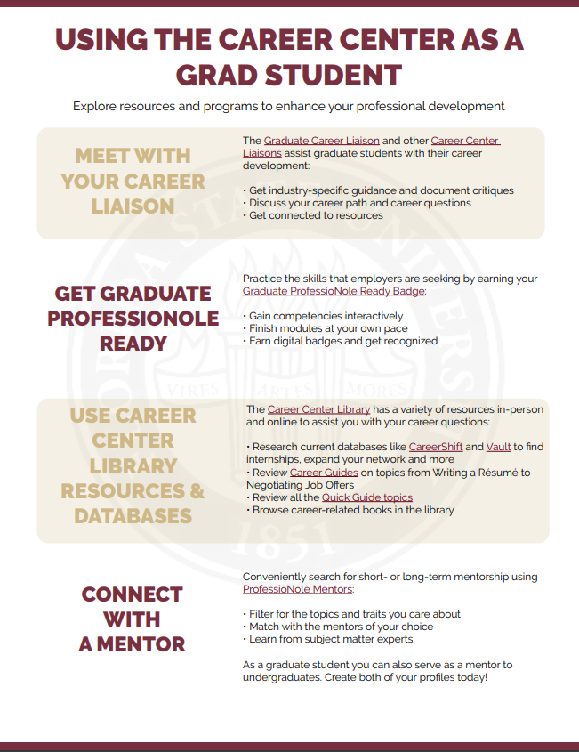
Getting Started
The Career Center has a series of “Quick Guides” to help get you started!
Check out the “Using the Career Center as a Grad Student” guide for steps to take to enhance your career readiness.
As you can see the first step is to meet with a Liaison to build your plan.
Visit:
https://career.fsu.edu/resources/quick-guides

Slide 9
Helpful Resources
Quick Guides
Career Guides
Job Databases
Website
(Graduate Student Tab)
Meeting with a Career Advisor or Liaison is a great way to learn more about our resources & services.
You can learn more under the resources tab on our website. A few to highlight are listed below:
Mentor Database
Job Shadowing
Interview Prep
Clothing Closet

Slide 10
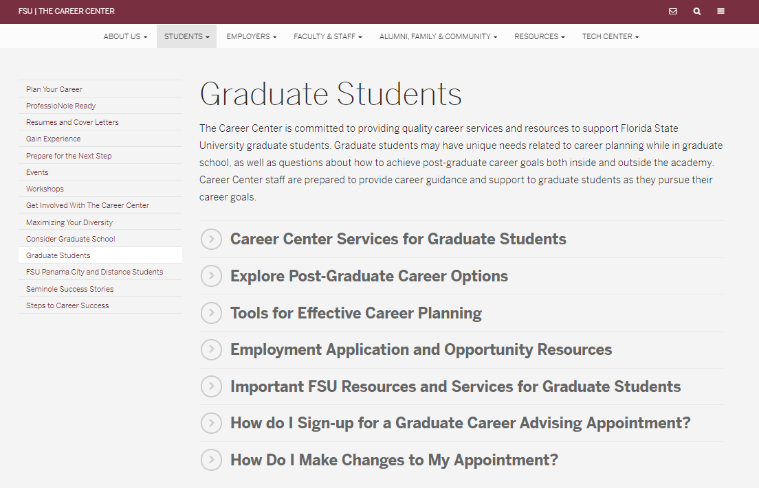
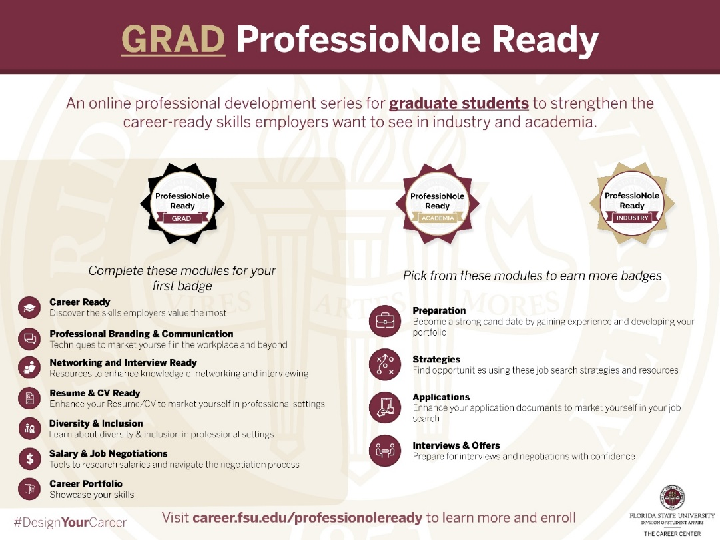
The Graduate Student tab on the website is a great place to start when looking for resources. You can explore options in academia and industry. You will also find information related to graduate career advising.
The Career Center has professional development resources like the Grad ProfessioNole Ready Canvas course as well as workshops, info sessions and other preparation events.

Slide 11
How We Can Help: We are excited for you to get started at FSU and with your next career step. The next few slides will walk you through some of the ways the Career Center can support you as a graduate student.

Slide 12
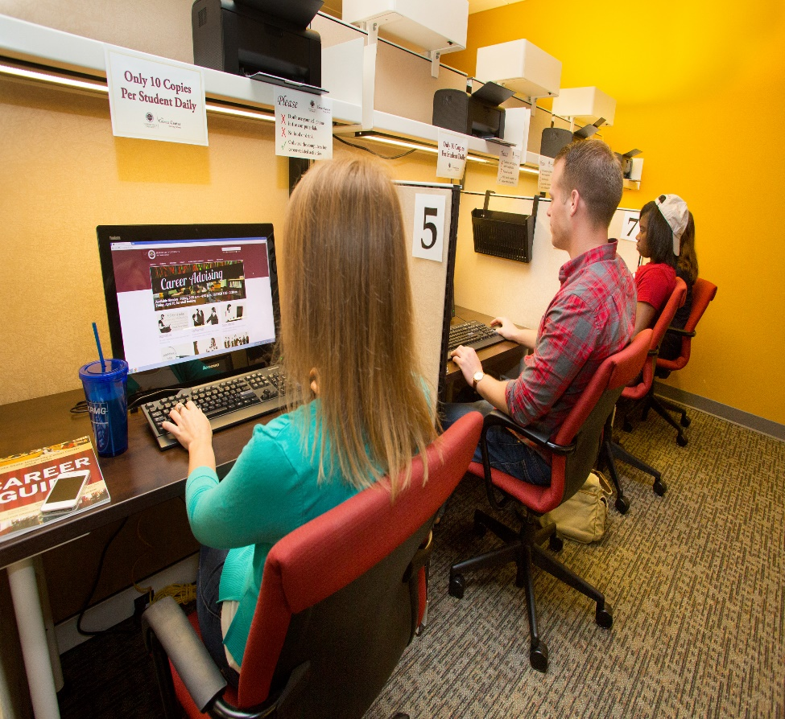
Explore Your Options
The Career Center encourages you to explore your career options and consider how earning your graduate degree will influence those options.
What are you interested in?
What skills do you have or do you want to build?
What values are important to you?
Asking these questions and working with the Career Center can help you to learn more about yourself and your career options.
Notes:
The Career Center is here to support your needs as graduate students:
Introduce topics of advising covered by liaisons and Career Advisors
Link to Graduate Student webpage on our website
Provide an overview of the GPNR Program for grad students

Slide 13
Earn Micro-credentials & Badges
Some of the career options you are considering may seek specific skill sets. Earning Micro-credentials and badges is one way to show employers these skill sets outside of hands-on experience.
We recommend exploring our badge options as well as using your access to LinkedIn Learning (free while an active student)
https://www.career.fsu.edu/professionolepathways

Slide 14
Connect with a Mentor
Conveniently search for short or long term- mentorship using ProfessioNole Mentors:
As a graduate student you can also serve as a mentor to undergraduates. Create both of your profiles today!
Filter for the topics and traits you care about
Match with the mentors of your choice
Learn from subject matter experts

Slide 15
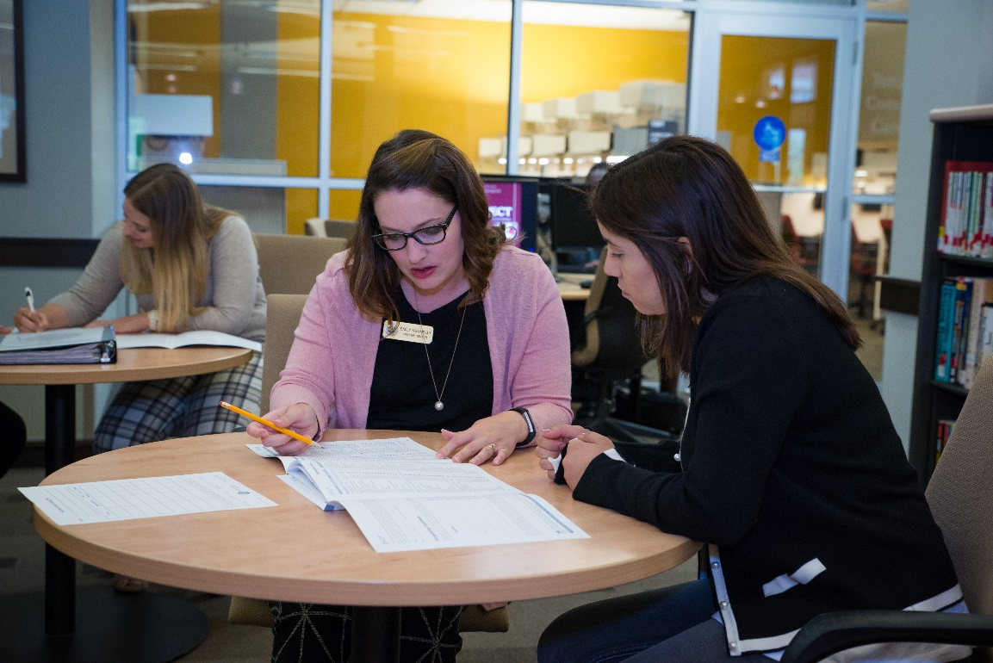
Prepare your Application Documents “If you are always ready, you never have to get ready”
Career Advisors and Liaison can review your Resume, CV, Cover Letters, Personal Statements and other application statements.
Consider keeping your Resume and/or CV updated each semester so it is ready for any opportunities. I recommend starting and ending each semester with a document review.
Career Center provides both synchronous and asynchronous methods for getting your documents reviewed.

Slide 16
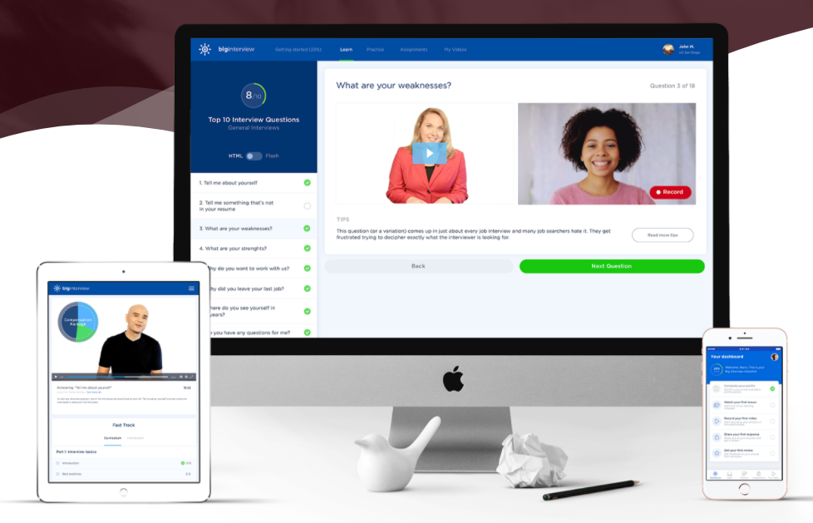
Practice your Interviewing Skills
Practices helps you to prepare for the real thing.
Take advantage of Big Interview
Complete a Mock Interview
Visit our interview prep site to learn more: https://www.career.fsu.edu/students/prepare-for-the-next-step/interview-preparation

Slide 17
Prepare for your Job Search
Concrete steps you can take:
Have your Résumé/CV reviewed each semester
Connect with a Mentor and attend networking events
Participate in Job Shadowing opportunities and explore openings
Create a portfolio to hold artifacts of your work, badges and certifications that you earn during your program
Use LinkedIn Learning and Digital Badges to expand your skill sets
Complete a mock interviews to enhance your interviewing skills
Need ideas for how YOU can prepare?
Meet with your Career Liaisons today!
Notes:
Life as a graduate student can get busy. Do not wait until you are about to graduate to begin preparing for your job search. Get started today:
You do not need to have all of the steps figured out, meet with your liaisons to discuss your path and steps to help you reach your career goals.

Slide 18
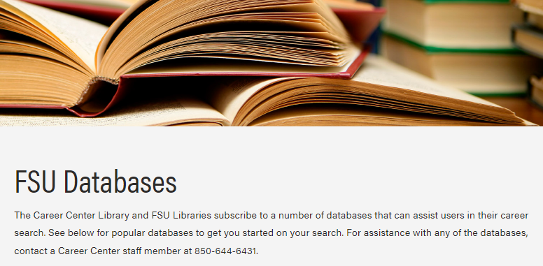
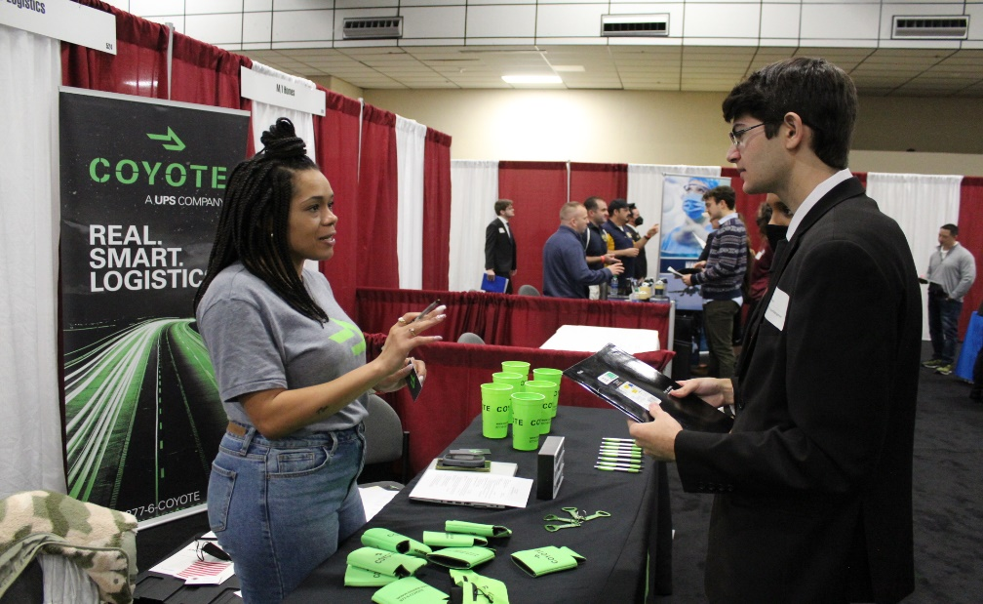
Launch your Job Search
Explore Career Center Job Boards
Academic and Industry Job Databases Available
NoleNetwork
CareerShift
GoinGlobal
Opportunities Tab with options by Industry
Attend Career Fairs
20+ Career Fairs offered per year
Seminole Futures All Majors Career Fair
STEM Career Fair
Government and Social Services Career Fair
Education & Library Career Fair
Graduate & Professional School Fair
Law School and Graduate School Fair

Slide 19
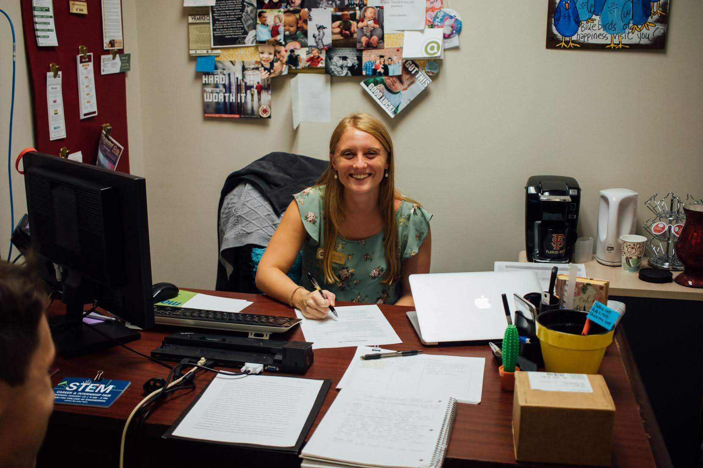
We Are Here With You!
Congratulations on joining the FSU Graduate School. We are so excited that you are here.
Remember that the Career Center is here to support you with your career development. Reach out with any questions, explore our resources and let us know how we can help!
Megan Crowe, M.S., Ed.S.
Your Graduate Career Liaison

