Slide 1
The Nuts & Bolts of FSU Student Systems
New Graduate Student Orientation
Brian Barton
Senior Associate Dean for Enrollment & Finance

Slide 2
What do you need to know now?
1
How to access everything
2
Tuition and fee info
3
Tuition waivers
4
Health subsidy
5
Helpful resources

Slide 3
We are all connected by the internet, like neurons in a giant brain.
- Stephen Hawking

Slide 4
Know the State of Your Information
myFSU Portal
Who has time to go all over? Can’t I just find out what I need in one place?

Slide 5
Know Your Stats
Single sign-on all in one place
myFSU let’s you access all in one place:
Email
Contact info
Canvas
Courses / un-official transcript
Your university finances

Slide 6
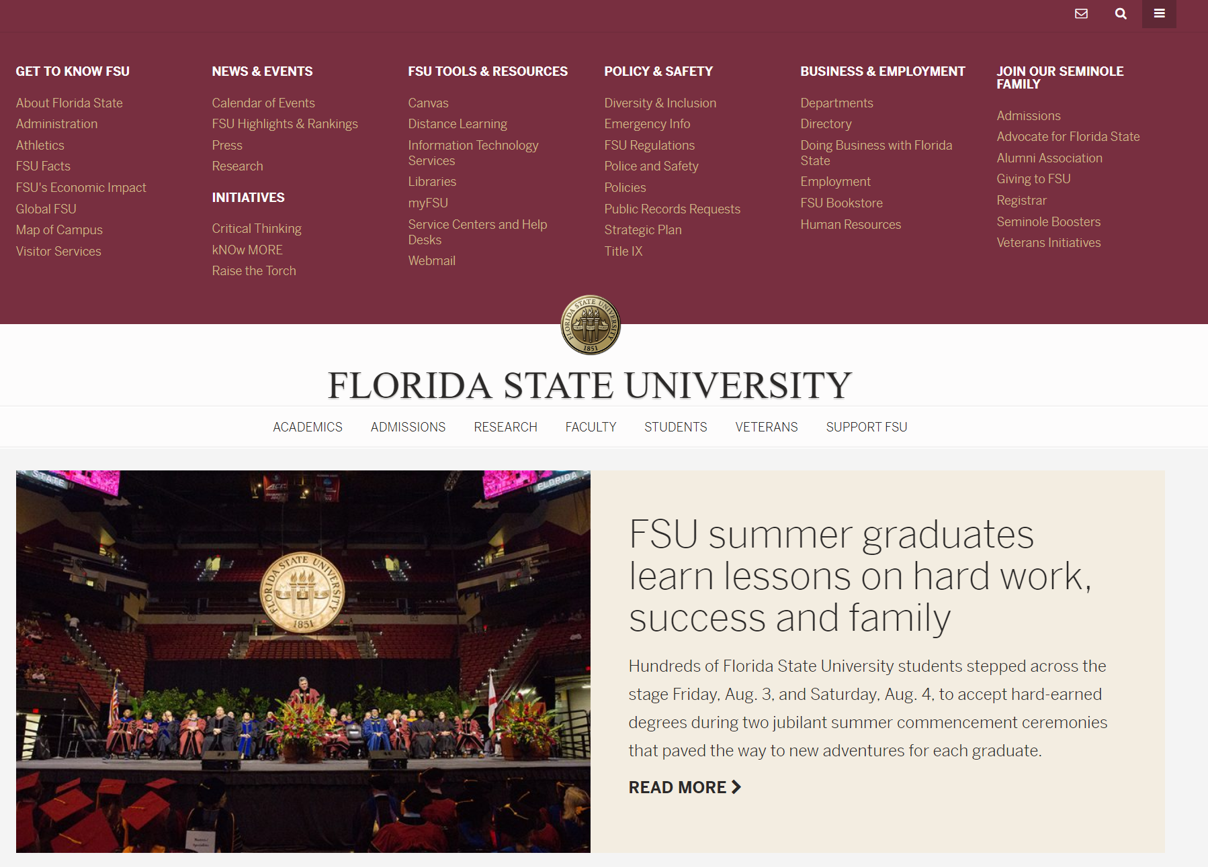
How to get in?
Getting to the portal

Slide 7
?
What to do and not to do

Slide 8
BE PREPARED
Graduate life
Pull your data
Look at your info, if it doesn’t look right ask somebody and correct it
Plan out your term
Get everything just like you want it
Don’t ignore, deal with announcements
Pop-ups are there for a reason
Stay connected
Check it often

Slide 9
Tuition & Assistantships
What is a tuition waiver?
Putting it all together
What does it cover, and what it doesn’t cover? A tuition waiver is offered as part of an assistantship. It covers the cost of your tuition, it does not cover your fees
Keep a close eye on things
Make sure sign your waiver receipt form and return it to your department.
Don’t be afraid to ask your supervisor questions
Someone has probably asked your question before.

Slide 10
Health Insurance
Who needs a policy? Can you bring your own? Can you purchase a policy? What are the minimum requirements? What do you need to know about the university-sponsored plan? How do you purchase the plan?

Slide 11
Health Subsidy Benefit
How we will help
What is the subsidy? Who is eligible? How does it work? How much is it?
Click on video to the right to learn all about the health insurance subsidy.

Slide 12
Other items
Data for everyone
Financial planning, tax help, other resources available on campus

Slide 13
References/Links
Graduate School Website: www.gradschool.fsu.edu
Insurance Info (Purchase or Waive): https://studentinsurance.fsu.edu
myFSU portal: www.my.fsu.edu
Financial Resources: https://studentbusiness.fsu.edu/financial-literacy
Student Resilience Project: https://strong.fsu.edu
FSU Cyber Security: https://its.fsu.edu/ispo/policy
Division of Student Affairs: https://studentaffairs.fsu.edu
Health Insurance Subsidy Information: https://gradschool.fsu.edu/funding-awards/subsidy-benefit

Slide 14
Questions?
LET’S GET IN TOUCH
314 Westcott Building
(850) 644-3501
grad@fsu.edu

