Slide 1


Florida State University
Police Department
Welcome
New Graduate Students
Rhonda harris • assistant Vice President for safety & chief of police
Justin maloy • Deputy Chief of Police
Jason Trumbower • Captain of operations
Richard wooten • Captain of support services

Slide 2


Florida State University Police Department
Safety Matters at FSU!!
The Best Way to Stay Safe
Use Common Sense and Always Be Aware of Your Surroundings.
Take Advantage of the Security and Safety Resources Available at FSU.

Slide 3

Florida State University Police Department
How to Contact FSU Police
EMERGENCY- Call 911
Non-Emergency- 850-644-1234
REPORT.FSU.EDU
Silent Witness Crime Report

Slide 4



Florida State University Police Department
Emergency Notifications on Campus
FSU Alerts Page (alerts.fsu.edu)
Indoor and Outdoor Sirens
SMS Text Messages
E-mail
SeminoleSAFE Mobile App
Desktop Computer Alerts
Facebook, Instagram and Twitter
Over 30 total notification methods!

Slide 5
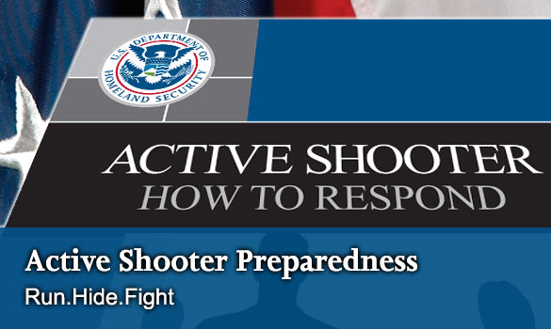

Florida State University Police Department
How We Train Our
Employees & Students
RUN HIDE FIGHT
In many cases, there is no pattern or
method to the selection of victims by an
active shooter, and these situations are,
by their very nature, unpredictable and
evolve quickly.

Slide 6
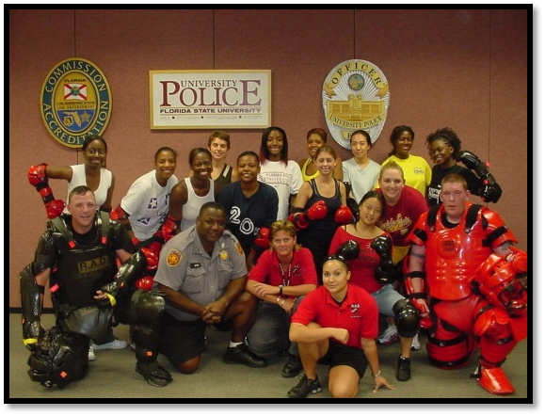
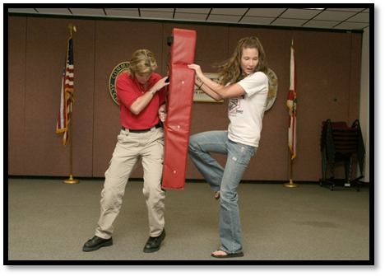


Florida State University Police Department
Rape Aggression Defense (RAD)
R.A.D. is a program of realistic self-defense tactics and techniques for women. The R.A.D. system is a comprehensive, women-only course of instruction that begins with awareness, prevention, risk, and risk avoidance. It then progresses to teaching hands-on self-defense training, but it is not a martial arts program.

Slide 7
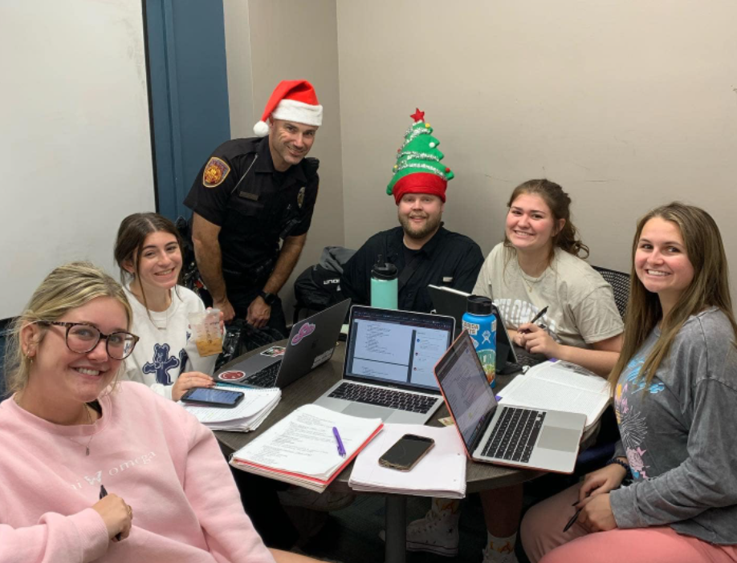


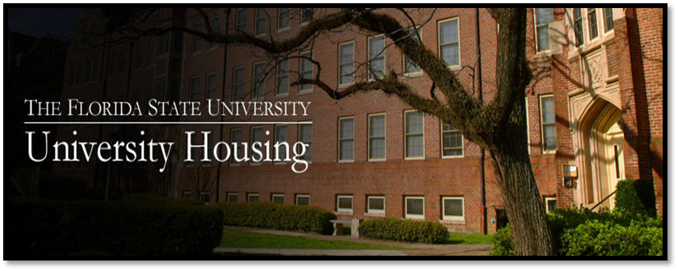
Florida State University Police Department
Adopt-A-Copp Program
The Adopt-A-Copp program is a way for FSUPD to provide positive interaction with its residence hall students in a unique capacity. The Adopt-A-Copps conduct educational and crime prevention programs, attend hall and staff meetings, and conduct periodic security checks of their halls. Adopt-A-Copps can become very popular in their halls!

Slide 8
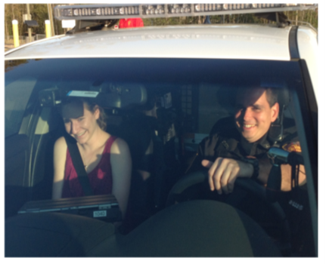
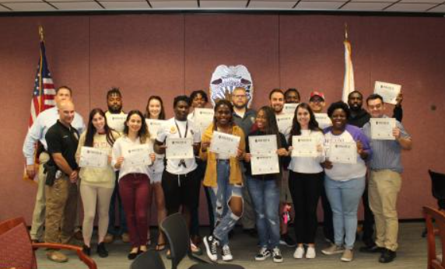
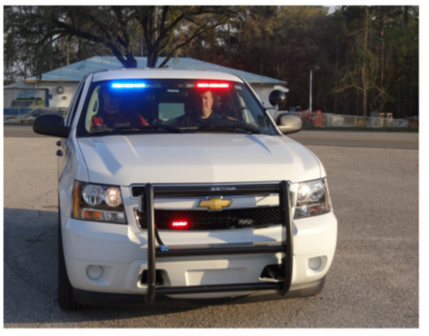
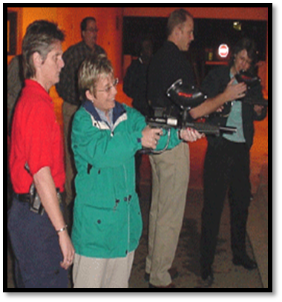
Florida State University Police Department
Citizens Police Academy
The Florida State University Police Department saw a need to provide an “inside view” of law enforcement operations to our campus community. We developed a curriculum and invited campus members (Faculty, Staff and Students) to join us for the Citizen’s Police Academy.

Slide 9













Florida State University Police Department
Local Law Enforcment Cooperation
Open Lines of Communication and Information Sharing with:
Local, State, Federal & RTCC

Slide 10
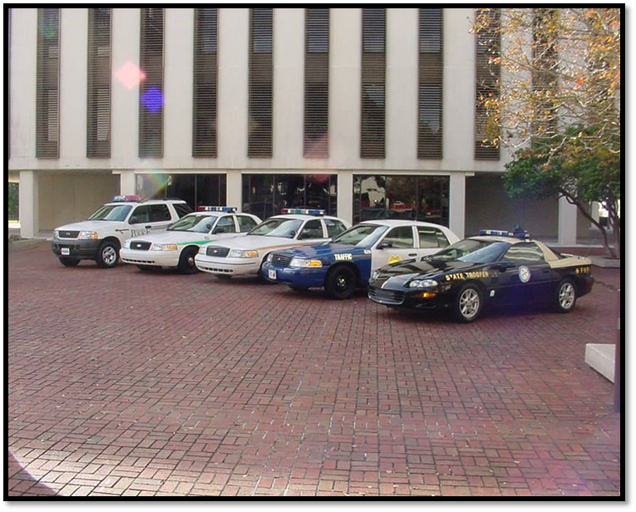





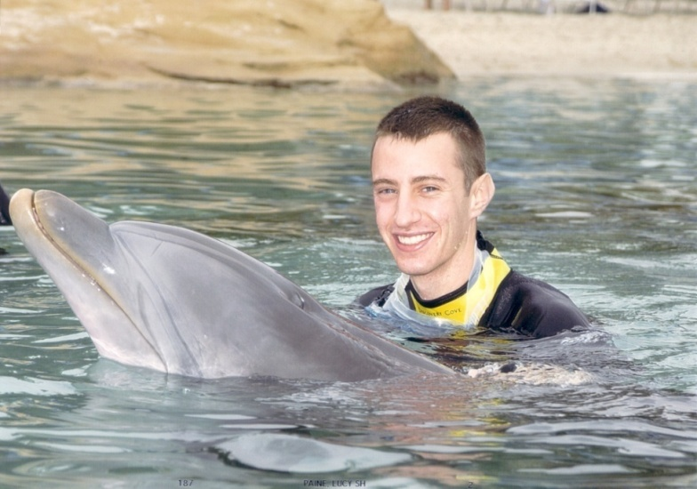

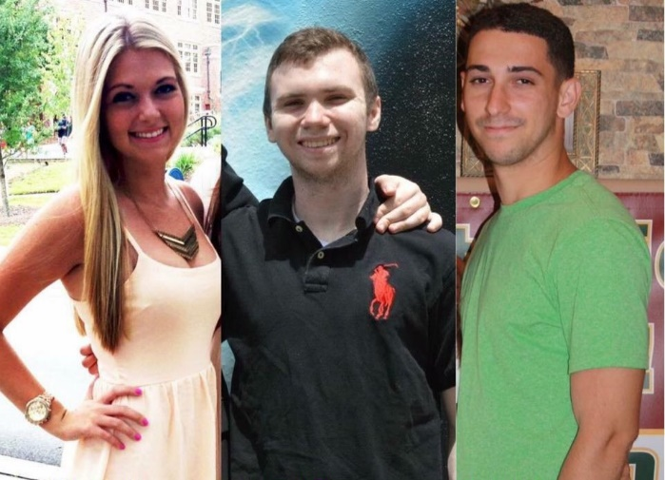


Florida State University Police Department
DUI Enforcement
The Tragic Cost of DUI – Lives Lost

Slide 11
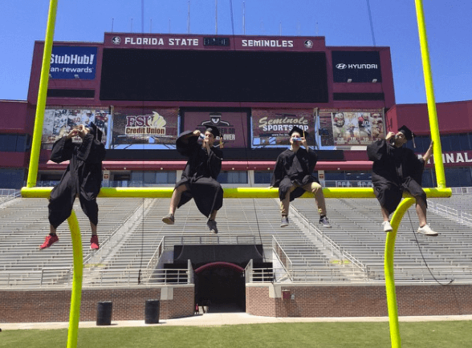
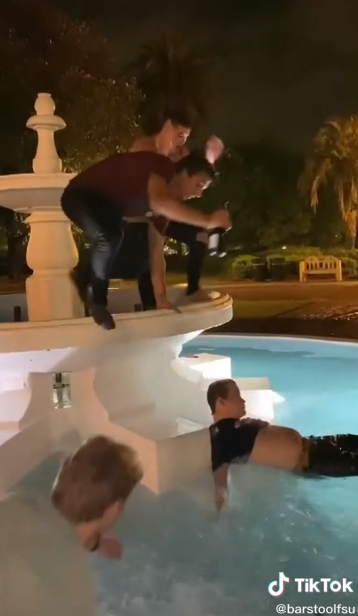
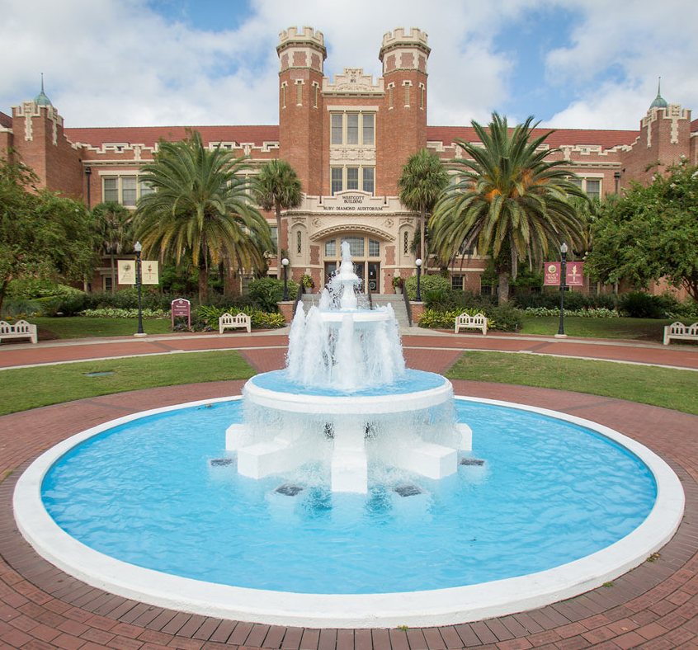
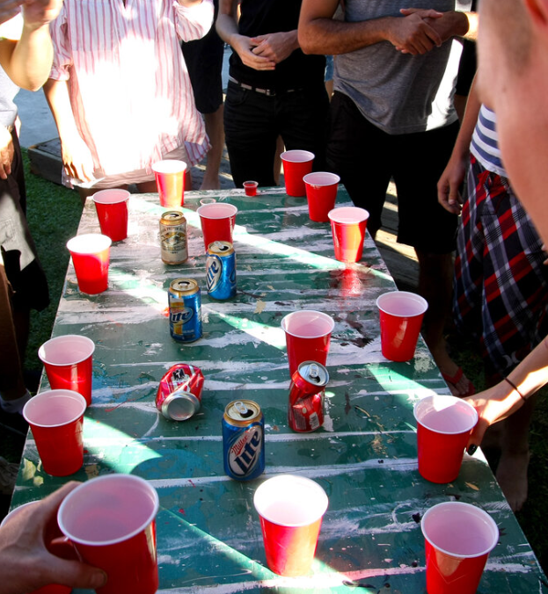
Florida State University Police Department
Avoid Dangerous behavior!!
Make GOOD Decisions!!!

Slide 12

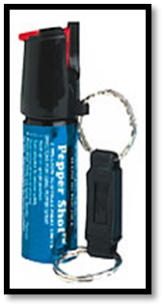

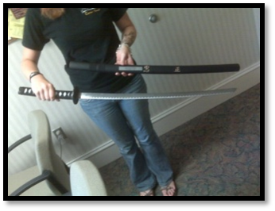
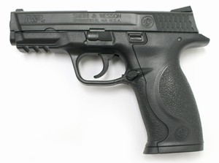

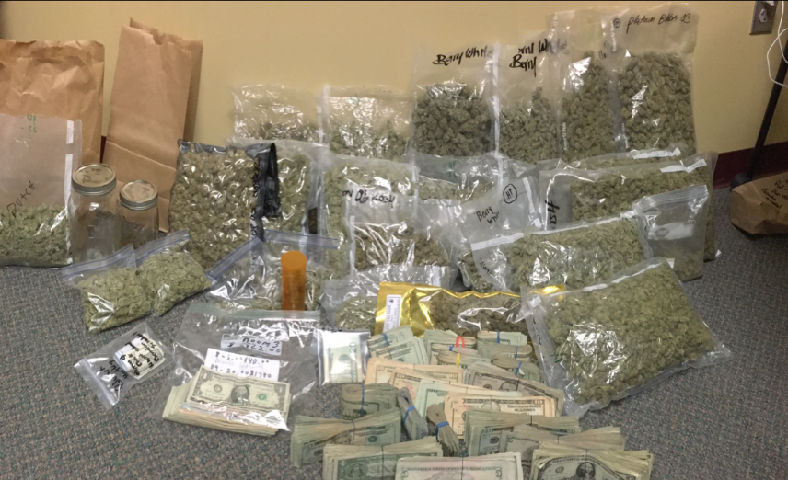
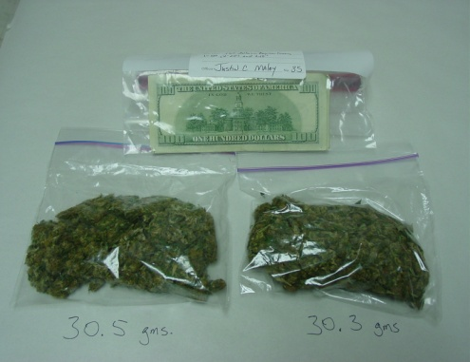


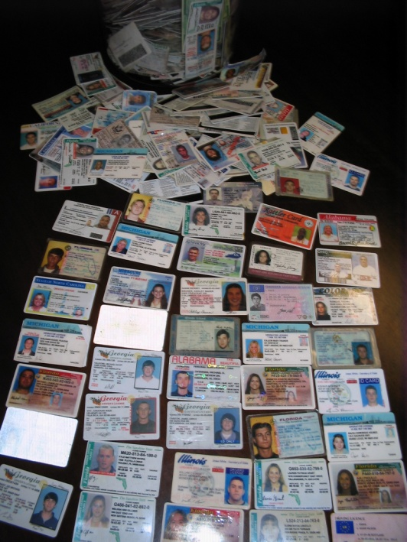
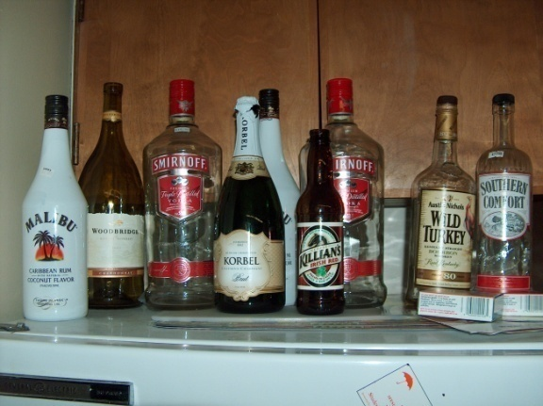

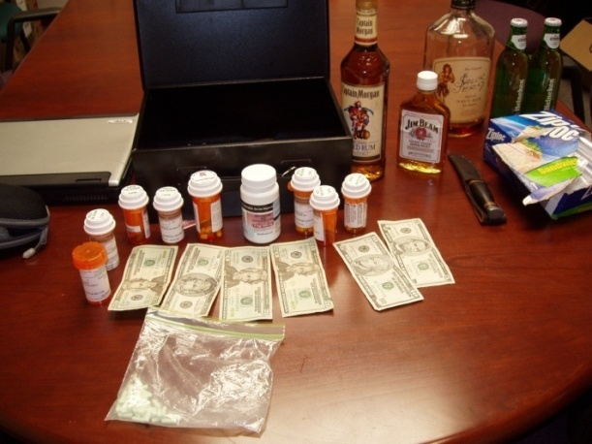

Florida State University Police Department
Bad Decisions
Let’s Have a
Serious Discussion!!

Slide 13
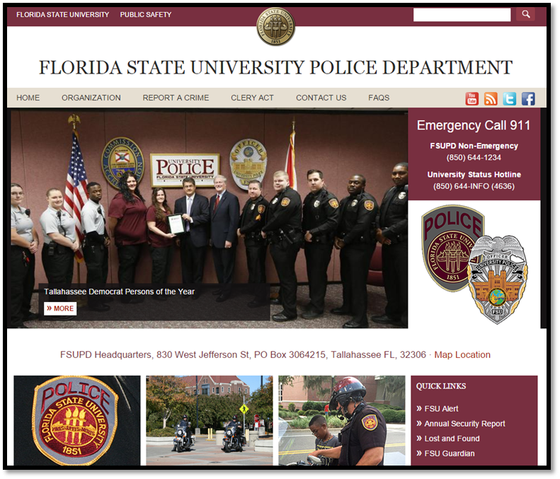
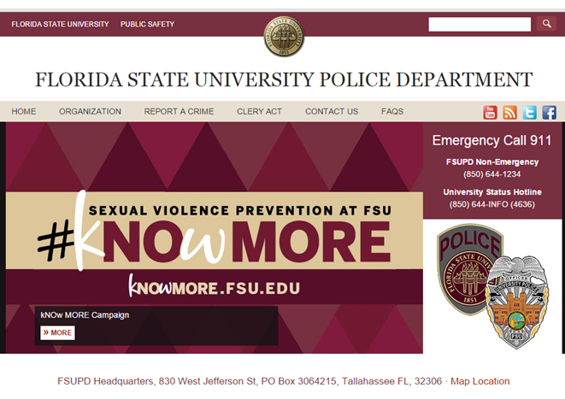
Florida State University Police Department
The FSUPD Website
Important Information & Resources
The FSUPD Website
www.police.fsu.edu

Slide 14




Florida State University Police Department
Safety Begins with YOU!
Thank YOU!

